Slide 1
ONLINE DIGITAL SHOPPINNG
BHARATHI RAJA P
GOPALA KRISHNAN S
DILLI KUMAR P S

Slide 2
PROJECT DESCRIPTION
The customers relation contains:-
Customer id (Cus_ID), Customer's name (Cus_Name) contains both first and last name of the customer,
To contact the customer we have their:-
Email id of the customer (Email_id),
Their house address / geolocation address (Street),
The city where the customer's house located (City),
To deliver the contents purchased by the customer, have their pincode of the city (Pincode).
The customer's mobile number (Ph_no), is a multivalued attribuite.

Slide 3
The Products relation contains:-
1. The product id (Pro_ID) which uniquely identifies the product for what the administrator user searches for.
2. The name of the product (Pro_Name), can be used by both administrator and customer,
3. The price of each product is stored in price attribuite (Price),
4. Each product has its model, to determine that we use an attribuite that filters out on what model of the product the person is searching for (Model),
5. To acutally filter out a billion of product in a shopping database, we use an attribuite (Categories).
Each product is selected by the customer, which can be directly paid or stored in some bag for future payment. This is well done by the Cart relation, where we actually store the product and pay to buy them, and this relation contains:-
1. The cart id, since each person has his/her own cart, to identify them uniquely and wisely we use (Cart_ID) attribuite.
2. The Quantity of products present in the cart, is denoted and counted by (Quantity) attribuite,
3. The total cost of the cart is tallied by (Cost) attribuite.

Slide 4
This ultimately leads to Payment page, where the user actually pays the amount for the products he purchased, this relation contains:-
1. Payment ID to verify that the particular customer has done his payment to our database (Payment_ID),
2. Mode of payment i.e., credit or debit card, netbanking, paytm, gpay, etc., is given a responsibility to (Type) attribuite, to look over it,
3. Amount to be paid, denoted by (Amount) attribuite,
4. Date of payment including time, look after by (Payment_Date) attribuite,
After the payment is made, it redirects to Orders page or relation (in dbms), where it contains:-
1. The ID of the order, placed by the customer, actually holds the (Product_ID), being a foreign key for this relatio, taken care by (Order_ID) attribuite,
2. The date of delivery or expected date for delivery is mentioned and taken care by (Shipment_Date) attribuite,
3. The date of order is the date of payment done by the customer is reflected in the attribuite (Order_Date),
4. And this order is placed to the address mentioned by the customer, where it takes the values of Address mentioned by the customer.

Slide 5
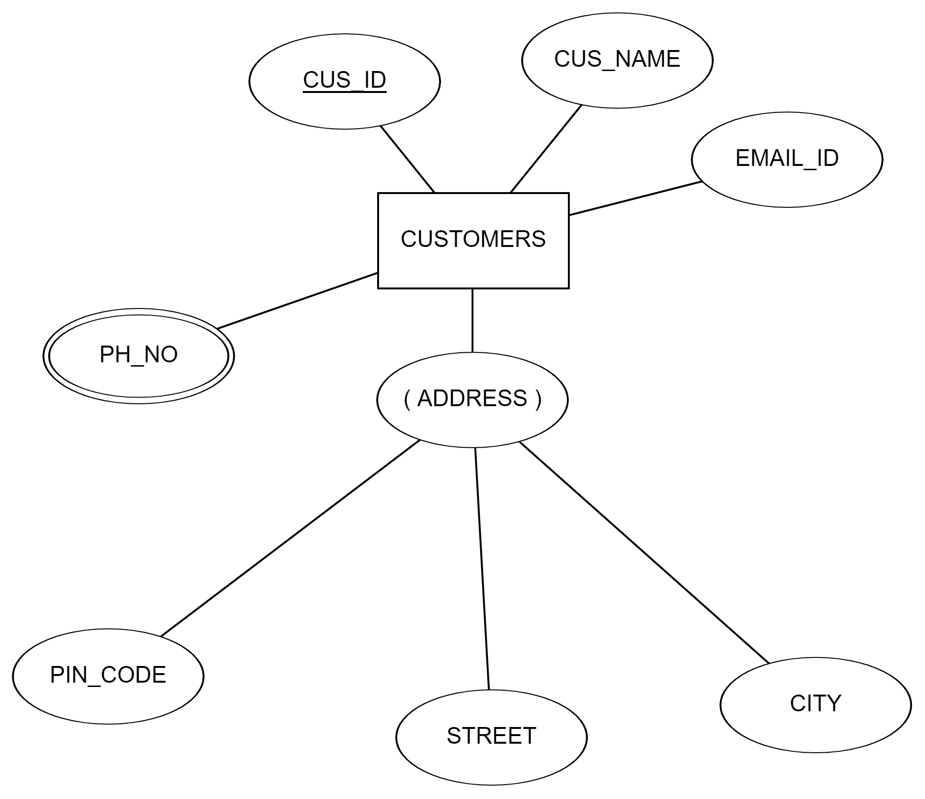
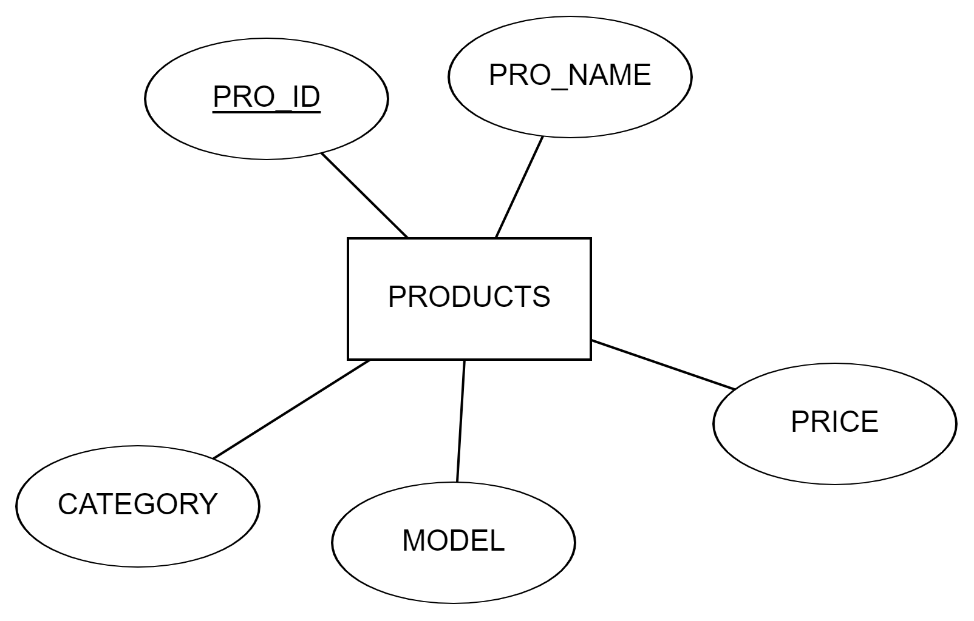
ENTITIES
CUSTOMERS
PRODUCTS

Slide 6
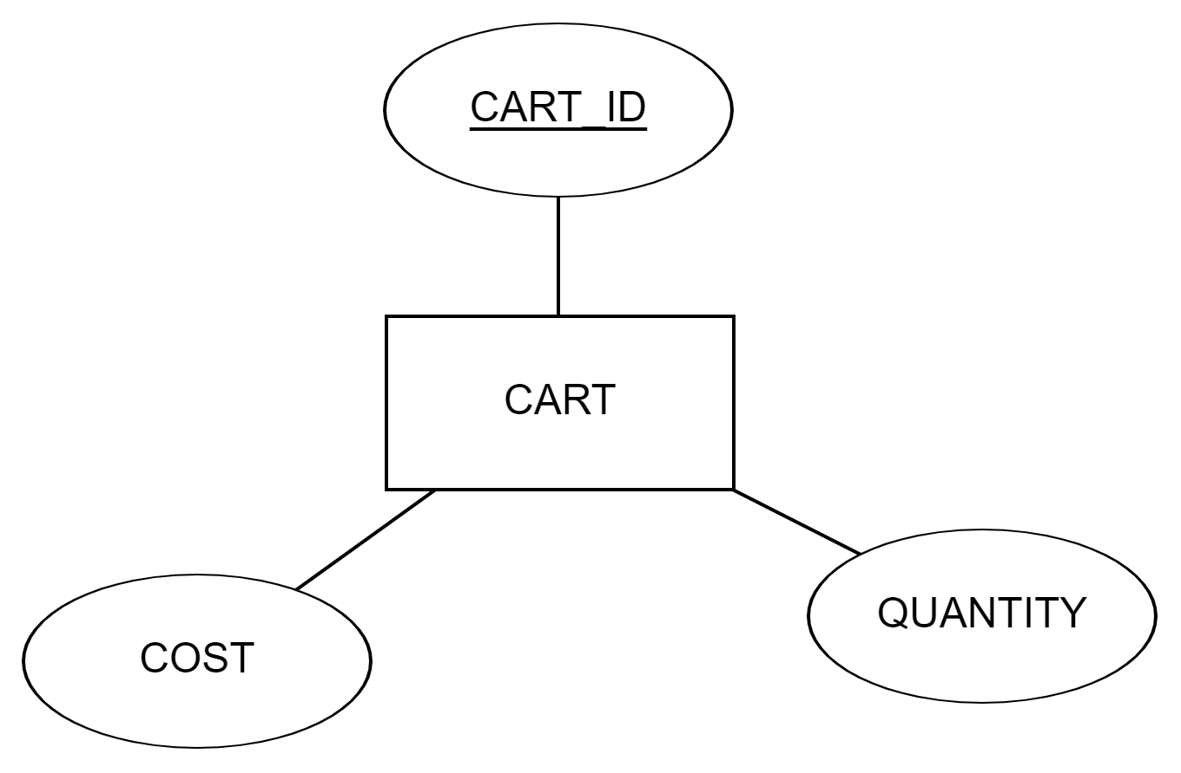
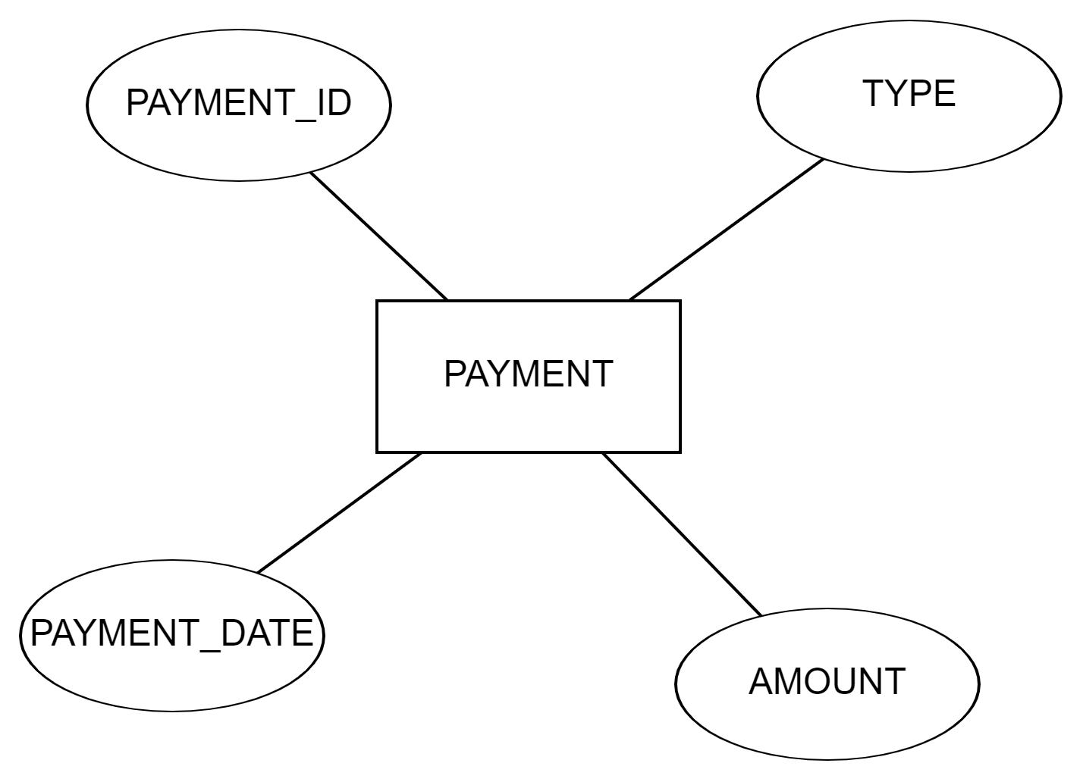
ENTITIES
CART
PAYMENT

Slide 7
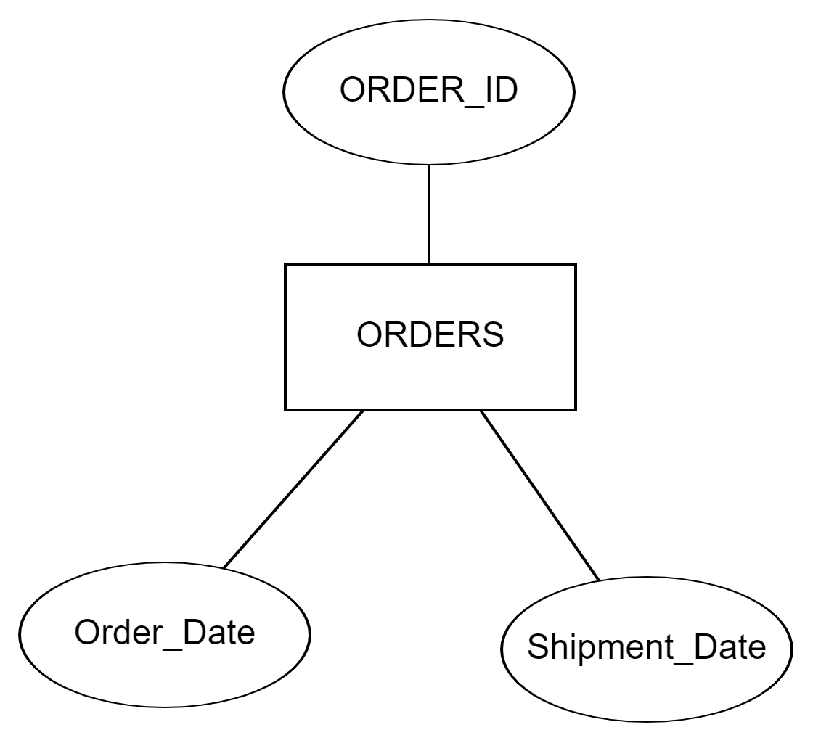
ENTITIES
ORDERS

Slide 8
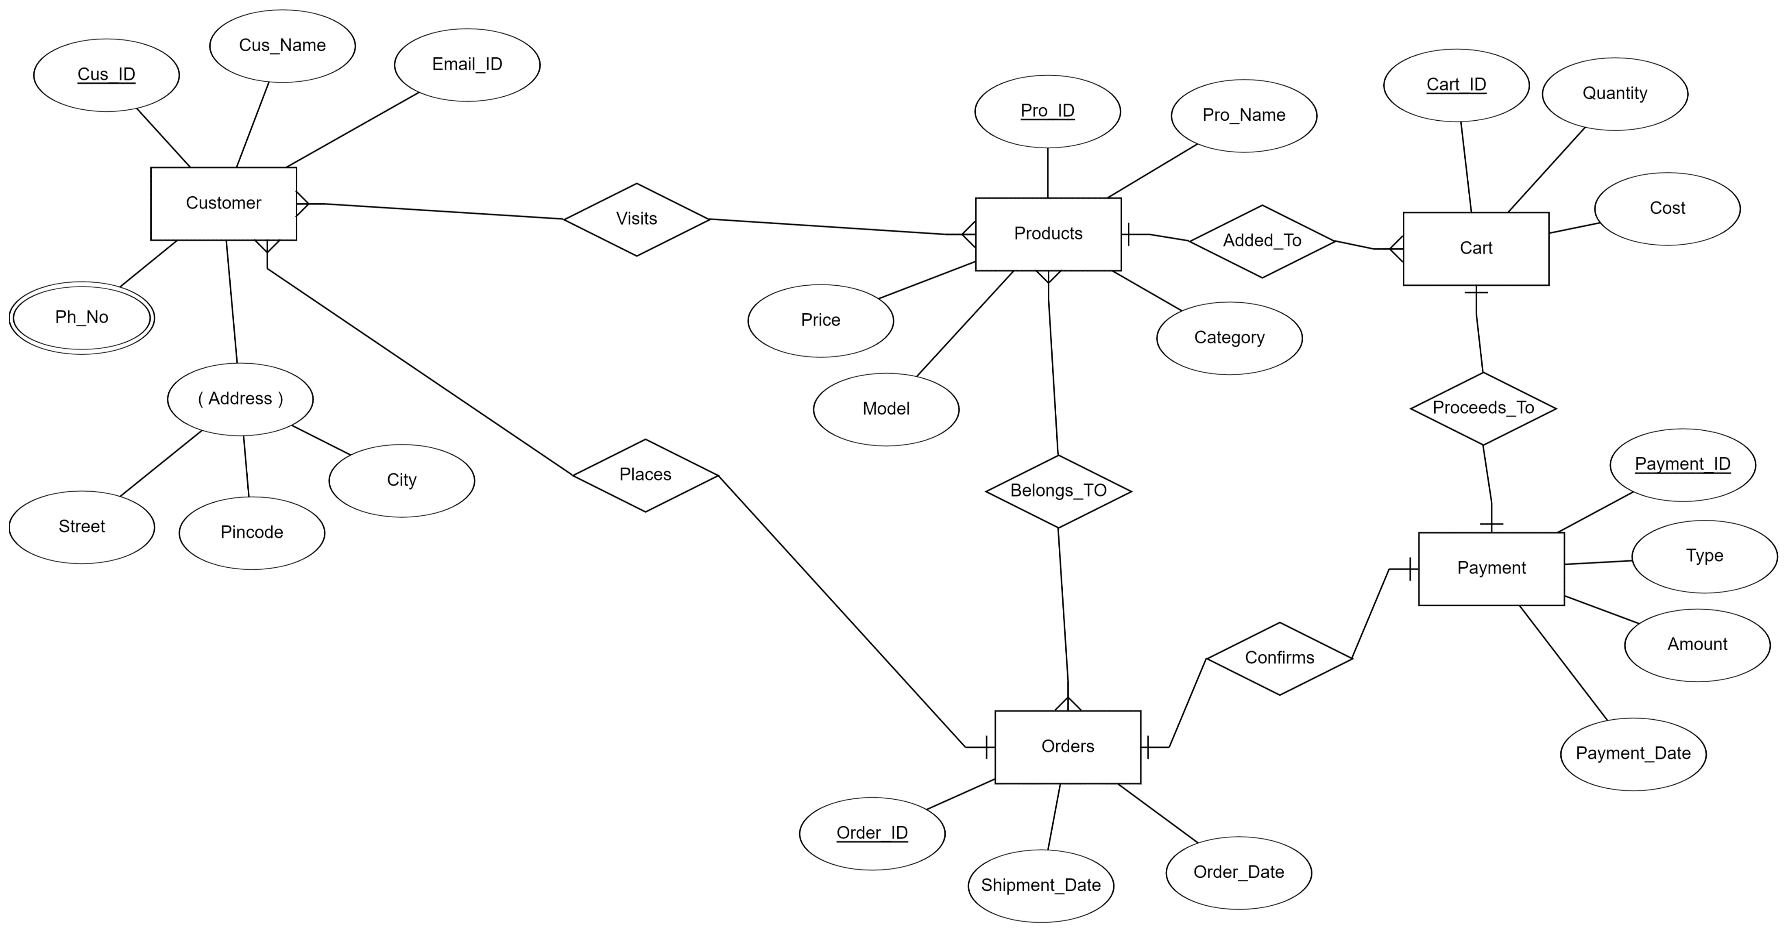
E R DIAGRAM

Slide 9
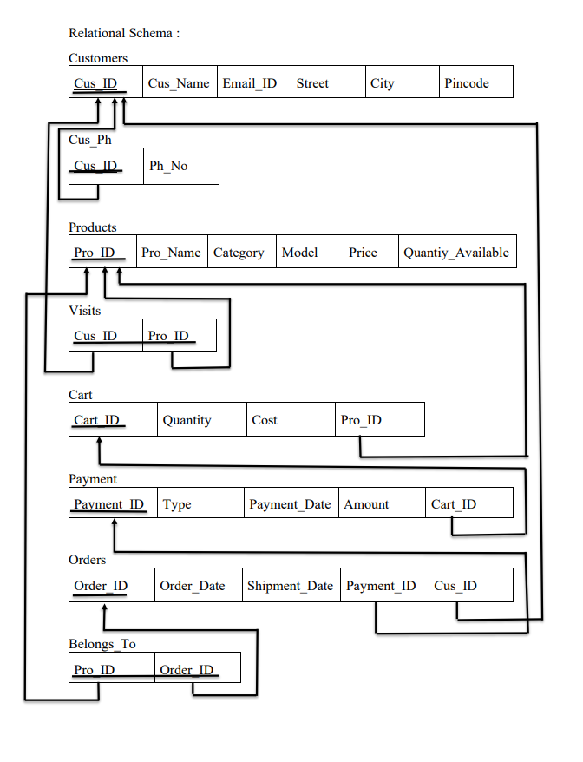

Slide 10
FUNCTIONAL DEPENDENCIES AND NORMALIZATION

Slide 11
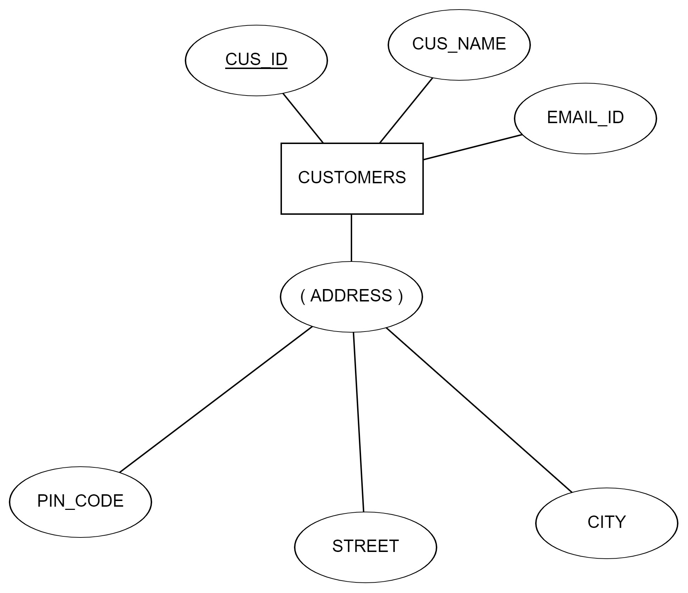
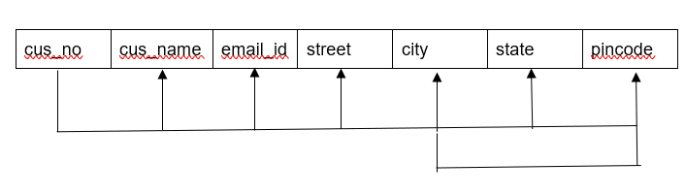
CUSTOMER TABLE
FUNCTIONAL DEPENDENCIES :
CUS_ID - > CUS_NAME, EMAIL_ID, STREET, CITY, PINCODE
CITY -> PINCODE

Slide 12
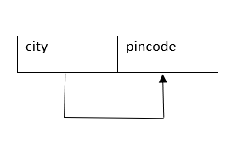
CHECKING FOR 1NF:
CHECKING FOR 1NF :
THERE IS NO MULTIVALUED,COMPOSITE ATTRIBUTES AND NESTES RELATIONS AND IT CONTAINS ONLY ATOMIC VALUES. THEREFORE, IT SATISFIES 1NF.
CHECKING FOR 2NF :
IT DOESN’T CONTAIN ANY PARTIAL FUNCTIONAL DEPENDENCIES. THEREFORE, IT SATISFIES 2NF.
CHECKING FOR 3NF :
IT DOESN’T SATISFY THE 3NF, BECAUSE THERE IS A TRANSITIVE DEPENDENCY. THUS DECOMPOSE THE TABLE AS FOLLOWS.

Slide 13
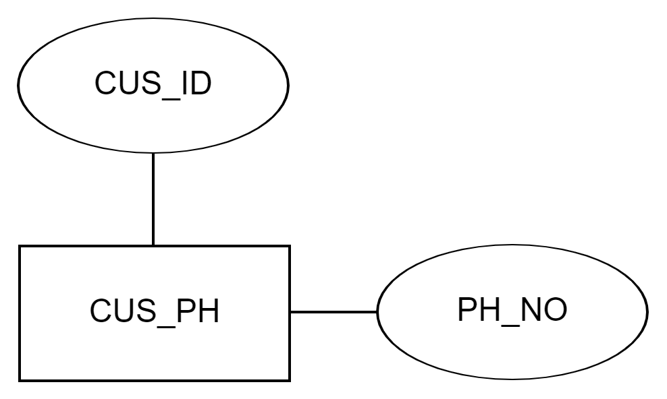
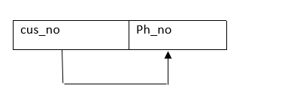
CUS_PH TABLE
Functional dependencIES :
CUS_ID -> PH_NO

Slide 14
CHECKING FOR 1NF :
THERE IS NO MULTIVALUED,COMPOSITE ATTRIBUTES AND NESTES RELATIONS AND IT CONTAINS ONLY ATOMIC VALUES. THEREFORE, IT SATISFIES 1NF.
CHECKING FOR 2NF :
IT DOESN’T CONTAIN ANY PARTIAL FUNCTIONAL DEPENDENCIES. THEREFORE, IT SATISFIES 2NF.
CHECKING FOR 3NF :
IT DOESN’T CONTAIN ANY TRANSITIVE DEPENDENCIES. THEREFORE, IT SATISFIES 3NF

Slide 15
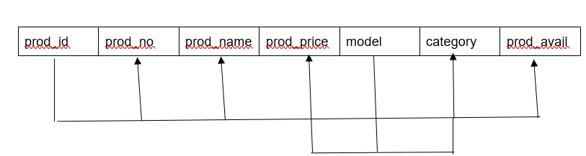
PRODUCTS TABLE
FUNCTIONAL DEPENDENCIES :
PRO_ID -> Pro_NAME, CATEGORY, MODEL, QTY_AVAILABLE.
CATEGORY, MODEL -> PRICE

Slide 16
CHECKING FOR 1NF :
THERE IS NO MULTIVALUED,COMPOSITE ATTRIBUTES AND NESTES RELATIONS AND IT CONTAINS ONLY ATOMIC VALUES. THEREFORE, IT SATISFIES 1NF.
CHECKING FOR 2NF :
IT DOESN’T CONTAIN ANY PARTIAL FUNCTIONAL DEPENDENCIES. THEREFORE, IT SATISFIES 2NF.
CHECKING FOR 3NF :
IT DOESN’T CONTAIN ANY TRANSITIVE DEPENDENCIES. THEREFORE, IT SATISFIES 3NF

Slide 17
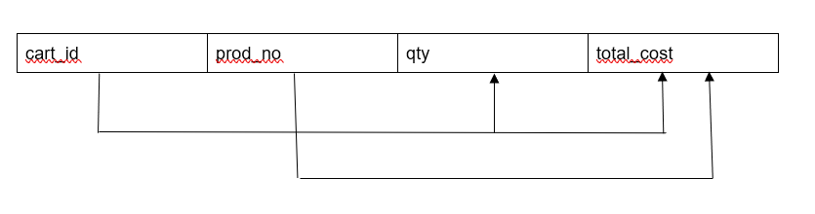
CART TABLE
FUNCTIONAL DEPENDENCIES :
Cart_id -> quantity, cost.
Pro_id, Quantity -> cost.

Slide 18
CHECKING FOR 1NF :
THERE IS NO MULTIVALUED,COMPOSITE ATTRIBUTES AND NESTES RELATIONS AND IT CONTAINS ONLY ATOMIC VALUES. THEREFORE, IT SATISFIES 1NF.
CHECKING FOR 2NF :
IT DOESN’T CONTAIN ANY PARTIAL FUNCTIONAL DEPENDENCIES. THEREFORE, IT SATISFIES 2NF.
CHECKING FOR 3NF :
IT DOESN’T CONTAIN ANY TRANSITIVE DEPENDENCIES. THEREFORE, IT SATISFIES 3NF

Slide 19
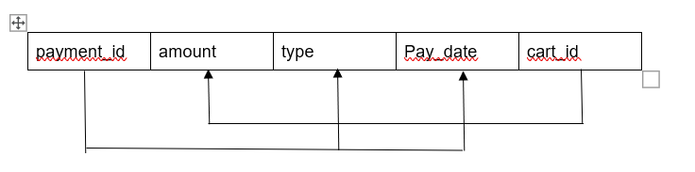
PAYMENT TABLE
FUNCTIONAL DEPENDENCIES :
CART_ID -> AMOUNT
PAYMENT_ID -> PAYMENT_DATE, TYPE

Slide 20
CHECKING FOR 1NF :
THERE IS NO MULTIVALUED,COMPOSITE ATTRIBUTES AND NESTES RELATIONS AND IT CONTAINS ONLY ATOMIC VALUES. THEREFORE, IT SATISFIES 1NF.
CHECKING FOR 2NF :
IT DOESN’T CONTAIN ANY PARTIAL FUNCTIONAL DEPENDENCIES. THEREFORE, IT SATISFIES 2NF.
CHECKING FOR 3NF :
IT DOESN’T CONTAIN ANY TRANSITIVE DEPENDENCIES. THEREFORE, IT SATISFIES 3NF

Slide 21
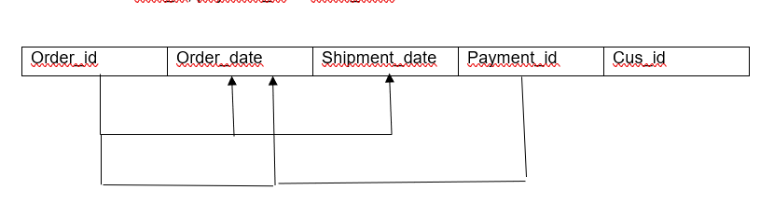
ORDERS TABLE
FUNCTIONAL DEPENDENCIES :
ORDER_ID -> ORDER_DATE, SHIPMENT_DATE.
CUS_ID, PATMENT_ID-> ORDER_DATE

Slide 22
CHECKING FOR 1NF :
THERE IS NO MULTIVALUED,COMPOSITE ATTRIBUTES AND NESTES RELATIONS AND IT CONTAINS ONLY ATOMIC VALUES. THEREFORE, IT SATISFIES 1NF.
CHECKING FOR 2NF :
IT DOESN’T CONTAIN ANY PARTIAL FUNCTIONAL DEPENDENCIES. THEREFORE, IT SATISFIES 2NF.
CHECKING FOR 3NF :
IT DOESN’T CONTAIN ANY TRANSITIVE DEPENDENCIES. THEREFORE, IT SATISFIES 3NF

Slide 23
THANK YOU

